Slide 1
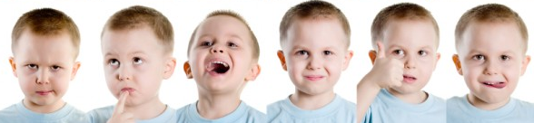
G107 Effective Communication
L05 You Say It Best When You Say Nothing At All
6th Presentation

Slide 2
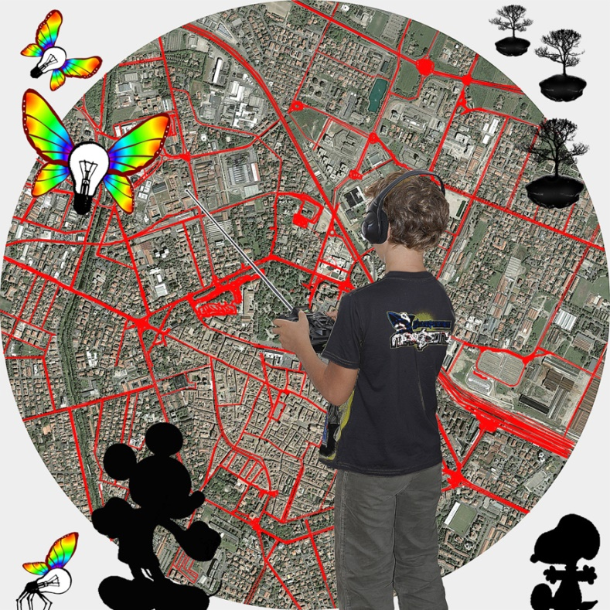
Learning Outcomes
Identify common non-verbal communication cues.
Interpret non-verbal behaviour and explain how it aids or hinders communication.
Demonstrate appropriate non-verbal behaviour as part of the presentation delivery.
Notes:
All pix taken from Google images

Slide 3
The Problem Analysis
Do verbal and non-verbal cues help or hinder communication? When does that happen?
What kinds / types of non-verbal behavior do we use in communication?
Who is involved in the communication process?
What roles do verbal and non-verbal cues play in the communication process?
Why do we use gestures, facial expressions, and actions in conversations with others?

Slide 4
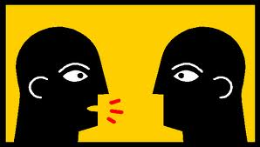
The Communication Process
The sender encodes non-verbal cues into the message (which could include both verbal and non-verbal components).
The non-verbal cues are decoded by the receiver.
Assumptions
Beliefs
Background
Barriers
Encode
Non-Verbal MESSAGE
Decode
SENDER
RECEIVER
Decode
Non-Verbal Feedback
Encode
Barriers
Assumptions
Beliefs
Background
CONTEXT

Slide 5
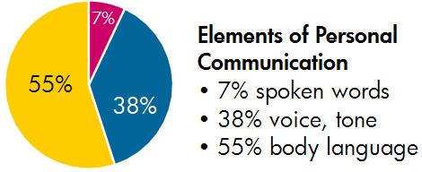
Communication
All forms of communication can be categorized as either verbal or non-verbal.
Research suggests that only 7% of a message is sent through words, with the remaining 93% sent by non-verbal expressions.

Slide 6
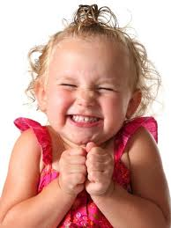
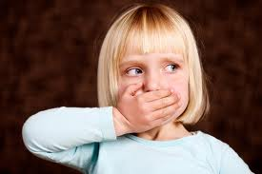
Communication
Verbal communication includes the spoken language.
Non-verbal communication involves communication that is transmitted through:
- paralanguage
- kinesics (body language)
- proxemics
- facial expression
- physical appearance
Notes:
REVISED

Slide 7
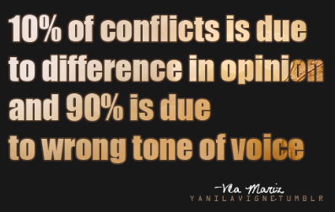
Non-verbal Communication
Paralanguage
The non-verbal qualities and modifiers of the voice. Volume, pitch, rhythm, use of pauses, taking turns in the conversation can place emphasis on certain words. The tone and quality of the voice are independent of the meaning of the spoken words used.

Slide 8
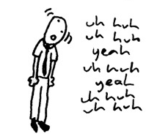
Non-verbal Communication
The use of fillers such as “umm… ahhh…” could be distracting but tonal variation or modulating your speech could make your speech interesting/ enhance message effectiveness in oral communication.

Slide 9
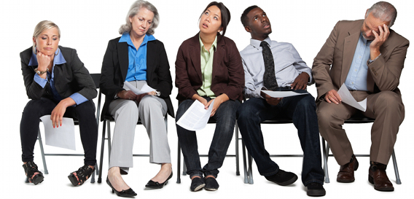
Non-verbal Communication
Kinesics (Body language)
Kinesics is the study of body language.
Body language can refer to gestures, postures, body movements and signals created by the person through his body language. e.g. expansively moving your arms about to show “huge” size. These body movements can emphasize your points if timed and executed correctly.

Slide 10
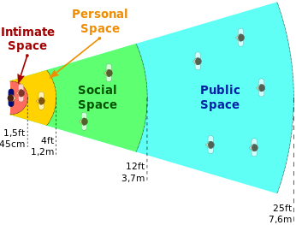
Non-verbal Communication
Proxemics:
The study of how we use and regulate our personal space.
There are 4 zones of personal space:
Intimate zone (16 inches or less)
Personal zone (1.5ft to 4ft)
Social zone (4ft to 12ft)
Public zone (more than 12ft)
The distance we put ourselves and other people sends a message.

Slide 11
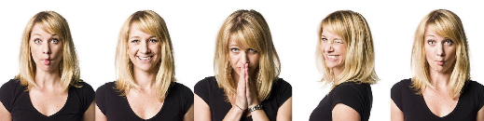
Non-verbal Communication
Facial Expression
Facial appearance– including the wrinkles, muscle tone and skin colour reveal information about the age, sex, race, ethnic origin and status. Expressions executed with these facial muscles can disclose feelings/emotions.
Facial cues such as the eyes, eyebrows, eyelids, cheeks, nose, mouth, lips and chin can convey emotions and attitudes as well. These cues can be deliberate or spontaneous.

Slide 12
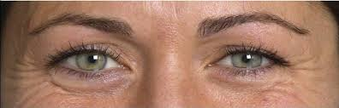
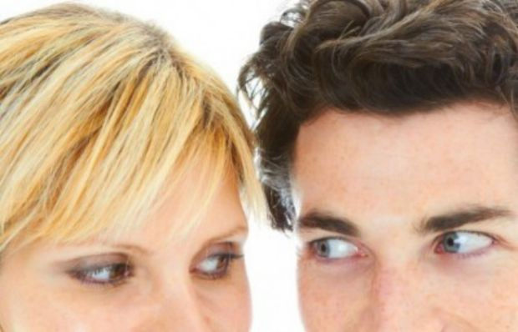
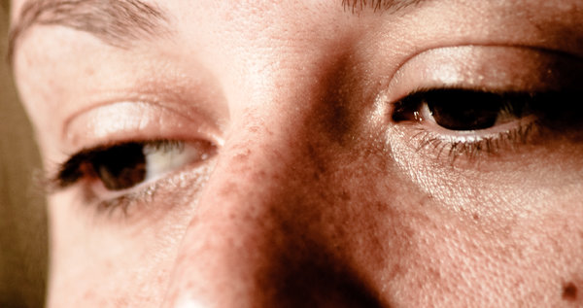
Non-verbal Communication
The eyes provide a constant channel of communication. They can be shifty and evasive; convey hate, fear and guilt; or express confidence, love and support.
Eye contact is often used to control an interpersonal interaction.

Slide 13

Non-verbal Communication
Physical Appearance / dressing
Dressing (including how we wear clothes & hair) portrays the background, personality, and values of the communicator. e.g. Going to your friend’s wedding in shorts, flip-flops and a stained singlet shows a disrespect for the hosts and occasion.
Note: Attire should match the occasion.
Gentle reminder: Final Presentation in Week 13

Slide 14
What Should You Do?
Don’t assume that you can interpret a non-verbal cue accurately
- Nonverbal cues may mean different things to different
cultures and societies. Be vigilant and respectful in
identifying NVC cues during your daily communication with
members of the same or different cultures.
Check out your perception
- Ask questions to clarify if your perception is correct.
Increase awareness of your own non-verbal cues
- Ask for feedback from the other party. Check if you are
sending out the wrong signals.

Slide 15

Application to the Problem:

Slide 16
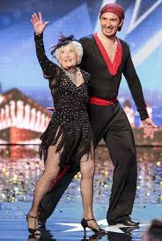
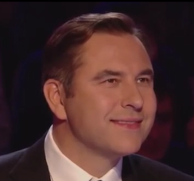
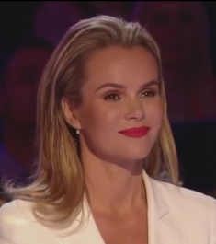
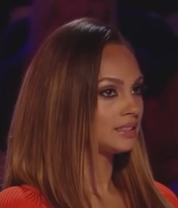
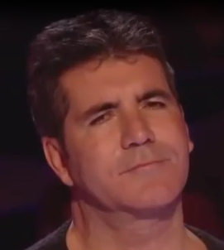
Application to the Problem:
David Williams
Amanda Holden
Paddy and Nico
Alesha Dixon
Simon Cowell

Slide 17
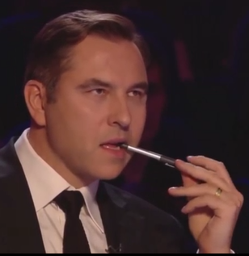
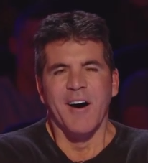

Judges’ NVCs
Part 1
The Slow Start
1:29
 | Kinesics | Facial Expression | Paralanguage / tone of voice | Possible Interpretation of NVCs
David | Biting his pen | Furrowed eyebrow | Nil | He doubts that the performance would be good
Simon | Nil | Yawning with squinted eyes and mouth wide opened | Nil | He is bored by the performance.
Alesha | Nil | Pursed lips | Nil | She is losing interest in the performance

Slide 18
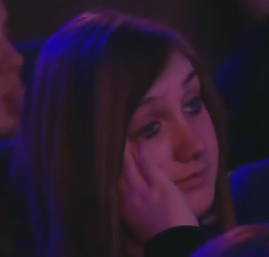

Audience’s NVCs
A
B
1:10
1:11
 | Kinesics | Facial Expression | Paralanguage / tone of voice | Possible Interpretation of NVCs
Person A | Hand on her face, head tilted to one side | Eyes half-closed, pursed lips | Nil | Person A is losing her patience and not excited about the performance.
Person B | Nil | Furrowed eye brow, pursed lips | Nil | Person B is getting bored and wondering if there will be more exciting moves from the team.

Slide 19
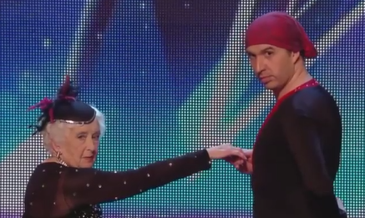
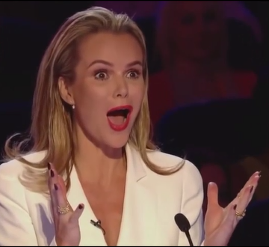
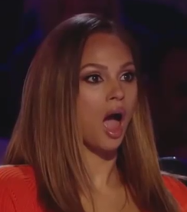


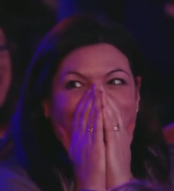

Part 2
The Fast Routine
1:33 – 2:20
Facial Expression:
Eyes and Mouth Wide-Open
Kinesics: Mouth covered with hands

Slide 20
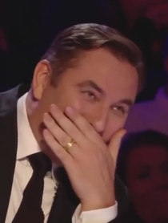
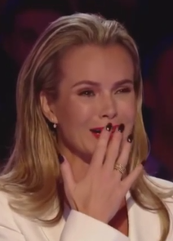

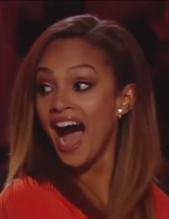
2:28
2:47
3:19
3:16
 | Kinesics | Facial Expression | Paralanguage / tone of voice | Possible Interpretation
David | Covered his mouth with his hand | Wide-eyed stare at the performers | Nil | He could not believe his eyes.
Amanda | Put her hand on her lips | Eyes squinting and in tears | Nil | She felt that the performance was beyond words.
Simon | Wide grin on his face | Wide-eyed stare at the performers | Nil | She felt that the performance was amazingly good.
Alesha | Turned her head and tilted her body towards David | Eyes and mouth wide opened | Gave a loud shriek | He felt that it was an unbelievable performance
Notes:
REVISED
Stared at the performance in disbelief.
Body tilted to share her amazement with David

Slide 21
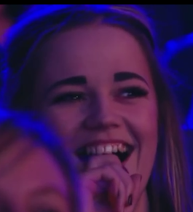
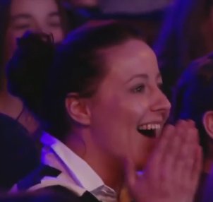
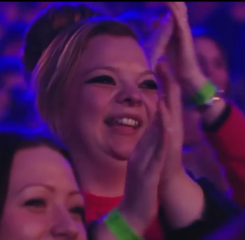
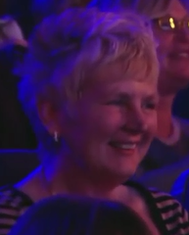
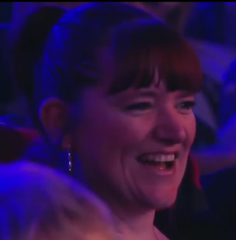
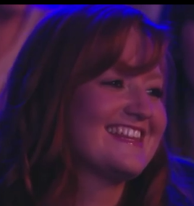
The Audience’s NVCs
0:23
2:48
3:43
1:49
1:54
5:26
Kinesics | Facial Expression | Paralanguage / tone of voice | Possible Interpretation of NVCs
Hands close to mouth Applause | Broad smile | Nil | The audience enjoyed the performance. It was an awesome performance.

Slide 22

At 4:00 – 4:22 The Confession
Simon’s Verbal Communication:
Simon: “I apologize for what I did because I obviously ‘buzzer-ed’ a little early. This is before all the crazy thing happened. It was like slow and normal and then it all went ballistic. It was extra-ordinary.” (solemn voice)
Simon’s non-verbal cues:
Kinesics | Facial Expression | Paralanguage / tone of voice | Possible Interpretation of NVCs
Placed his right hand on his heart Waved his hands when he was explaining | Had eye contact when complimenting the duo. | Spoke slowly Used fillers such as “ah” | It was a spectacular performance and he was too quick to write-off the duo. He felt bad and apologetic that he buzzer-ed too early.

Slide 23
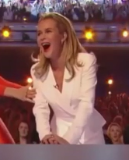
At 5:18 – 5:35 The Golden Buzzer
Amanda’s Verbal Communication:
“My grandmother is 93 years old and I just kept thinking of her when you were being thrown around by that man. I think she would have wanted me to press the buzzer for you as well. Me and nana are going to be right behind you and I hope you win Britain’s Got Talent!” [5:18 – 5:35]
Amanda’s non-verbal cues:
Kinesics | Facial Expression | Paralanguage / tone of voice | Physical Appearance | Possible Interpretation of NVCs
Pressed the golden buzzer with both hands Leaned body forward | Her eyes never left the pair on stage. Mouth wide open | Screaming High pitched | Formally dressed in suit and skirt | She is excited and feels that the performance is spectacular / unbelievable performance, especially from an almost 80 year old lady. It is the best she has seen tonight. She dresses formally to leave a good impression on the audience, as the show will be broadcasted internationally.

Slide 24
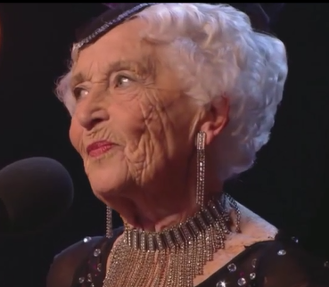
Are you sure you can dance?
BEGINNING
There is more to me than meets the eyes
NVC | Possible Interpretation
Squinted eyes | Suspicious if he will be surprised by her performance.
Pursed lips | Not anticipating any surprise element.
Head tilted to the side | A little sceptical.
Flat tone of voice | Not impressed. He doesn’t expect this pair to make it.
NVC | Possible Interpretation
Rolled her eyes | Not happy with his scepticism.
Pursed lips | Dissatisfied that he judged her too soon.
Head tilted to the side | Resigned to let him think what he wants.

Slide 25

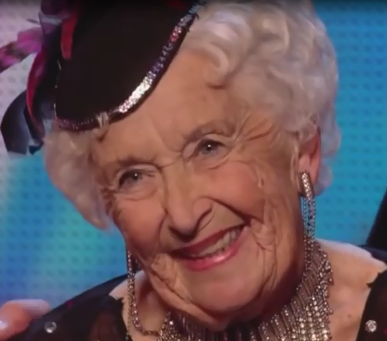
Thank you. I’m glad you enjoyed the performance
Amazing performance!
ENDING
NVC | Possible Interpretation
Smiley eyes | It was an incredible performance. He was filled with awe, admiration and respect for Paddy.
Wide smile with teeth showing
NVC | Possible Interpretation
Eyes opened wide | It was a good performance and she has completed her routine beautifully. She is happy with herself.
Wide smile with teeth showing
Head tilted

Slide 26
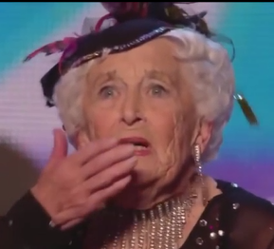

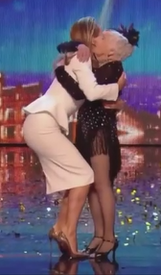
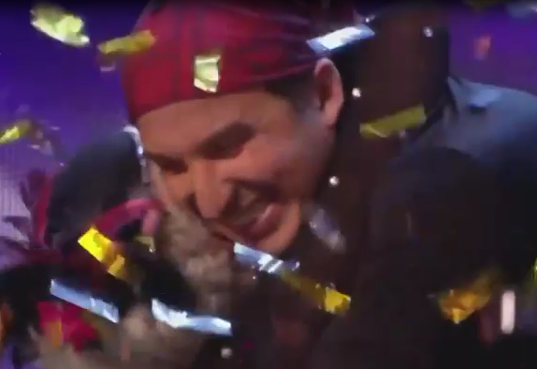
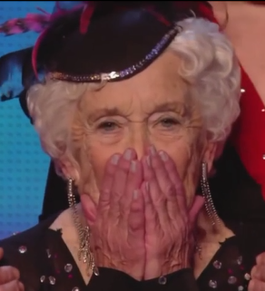
AMAZING MOMENTS

Slide 27
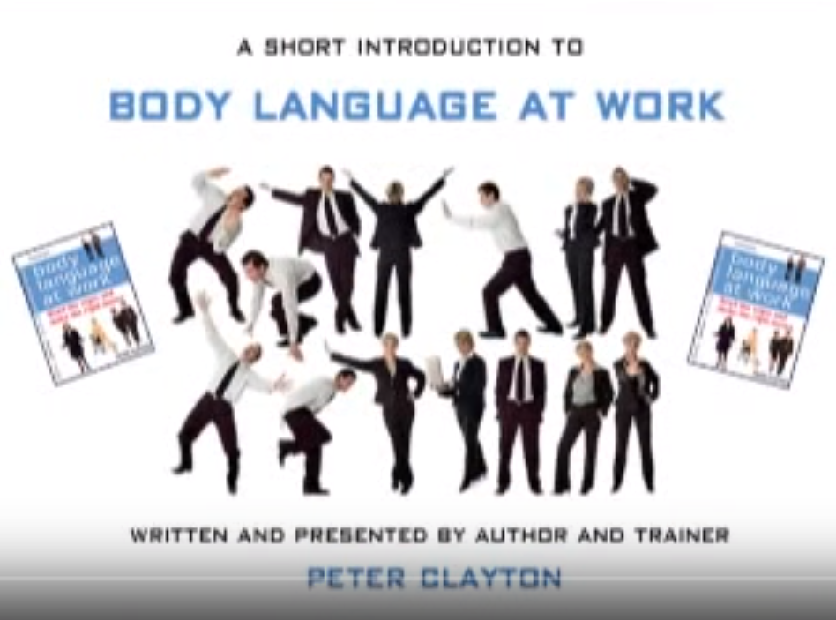
Extended Learning
Watch the following video:
(2008, December 18). Body Language at Work by Peter Clayton. Retrieved October 04, 2017, from https://www.youtube.com/watch?v=t-eC2QQ-nSM
Students are encouraged to take notes.

Slide 28
Concept Diagram
Paralanguage / Tone of voice
Non-verbal qualities and modifiers (e.g. volume, pitch, rhythm)
Kinesics (Body language)
Body Movements
Postures
Facial Expression
Facial Appearance
Physical Appearance
Dressing
Facial Cues (intentional / spontaneous)
Use of fillers
Artifacts (e.g. jewellery, personal belongings, accessories etc.)
Gestures
Eye Contact
Non-Verbal Communication

Slide 29
References
Dobkin, B.A., & Pace, R.C. (n.d.). Nonverbal Communication. Communication in a Changing World. Retrieved March 28, 2017, from http://highered.mcgraw-hill.com/sites/0072959827/student_view0/chapter6/
Introduction to Non Verbal Communication (n.d). Retrieved March 28, 2017, from GenEducation website, http://www.hrepic.com//Teaching/GenEducation/nonverbcom/nonverbcom.htm
Changing Minds (n.d). Retrieved March 28, 2017, from Using Body Language website, http://changingminds.org/techniques/body/body_language.htm
Clayton, P. (2015, September 16). Body Language at Work by Peter Clayton [Video file]. Retrieved from https://www.youtube.com/watch?v=t-eC2QQ-nSM

